Slide 1
Knowledge Graph Embedding (Trans-E,H,R)
(NIPS ‘13 - TransE) Translating Embeddings for Modeling Multi-relational Data
(AAAI ‘14 - TransH) Knowledge graph embedding by translating on hyperplanes
(AAAI ‘15 - TransR) Learning Entity and Relation Embeddings for Knowledge Graph Completion
Presenter : Cheonsol Lee
Date : 2021.07.02
Notes:
Translation model : 벡터 연산을 통해 지식 완성을 수행

Slide 2
1
TransE
2
TransH
INDEX
3
TransR
4
Conclusion

Slide 3
(NIPS ’13 – TransE)
Translating Embeddings for Modeling Multi-relational Data
Notes:
Translation model : 벡터 연산을 통해 지식 완성을 수행

Slide 4
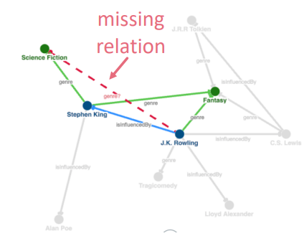
1. Background of KG embedding
Knowledge Graph(KG) is composed of triple like head(h), relation(r), and tail(t).
Background of graph embedding
Purpose : KG completion (= link prediction)
Learn to KG’s local & global pattern
Notes:
Entity, relation이 같은 차원에 표현됨

Slide 5
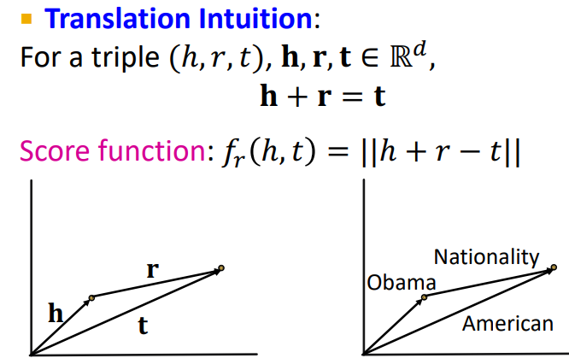
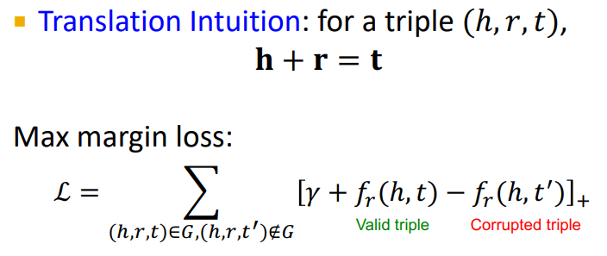
2. TransE
Score function : L1 or L2-norm
Training
Notes:
TransE : relation 을 저차원의 임베딩 된 구성요소로 전환(translation)

Slide 6
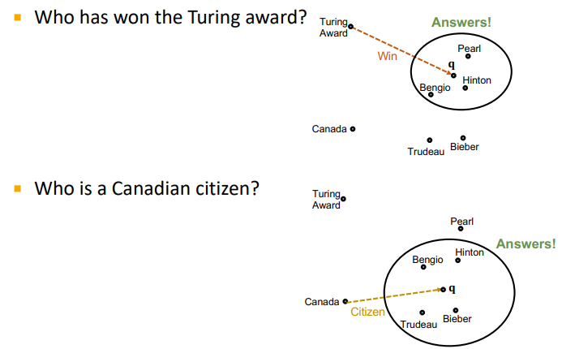
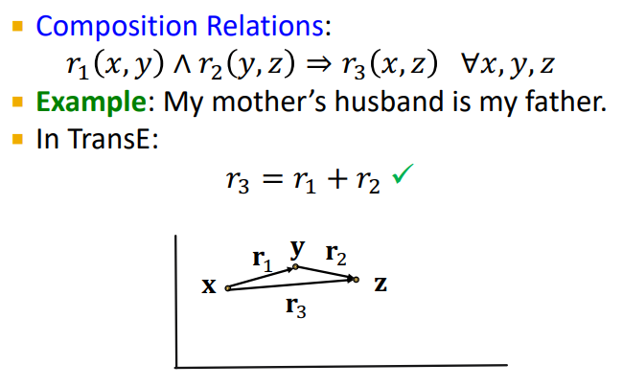
3. Application & feature
KG Completion(Link Prediction)
Composition Relation

Slide 7
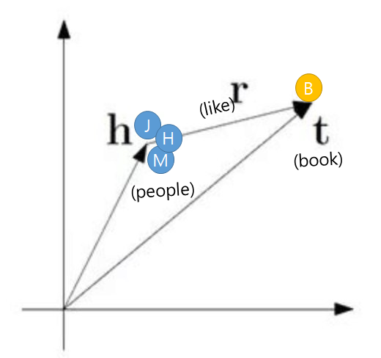
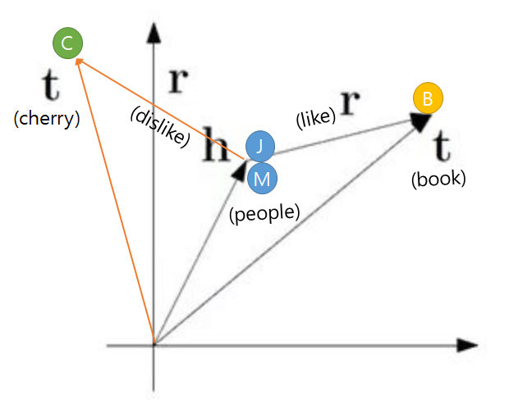
4. Limitations
1:1 (O)
1:M, M:1, M:N (X)
All entities belonging to multiple relations will have the same presentation.

Slide 8
(AAAI ’14 – TransH)
Knowledge graph embedding by translating on hyperplanes
Notes:
Translation model : 벡터 연산을 통해 지식 완성을 수행

Slide 9
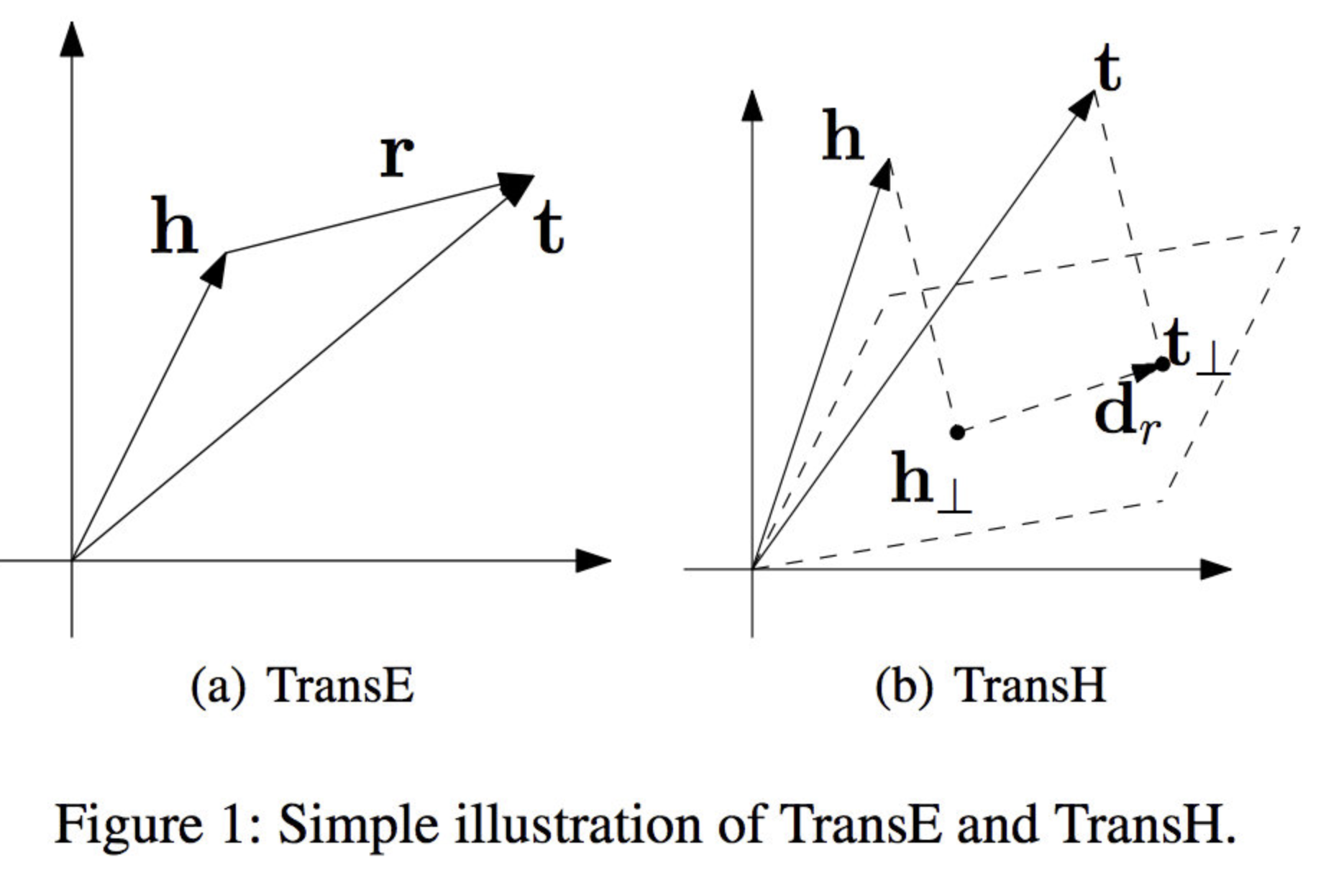
1. Distributed representations of entity
Project relation on hyperplane.
Project node on relation-specific hyperplane.
Notes:
모든 node는 각 relation마다 구분될 수 있습니다

Slide 10



1. TransH
Score function :
New vectors
W_r : norm vector to project entity into hyperplane
D_r : translation vector
<projected entities>
<Loss function>
Notes:
Relation마다 Entity들이 구분된다.

Slide 11
(AAAI ’15 – TransR)
Learning Entity and Relation Embeddings
for Knowledge Graph Completion
Notes:
Translation model : 벡터 연산을 통해 지식 완성을 수행

Slide 12
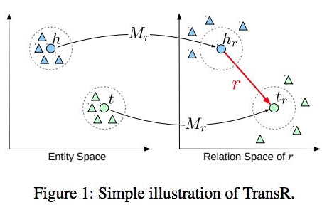
1. Problems of previous methods
A problem of previous model : TransE, TransH
Same embedding space
Why is same embedding space a problem?
The entity can have many aspects(features).
Many relations focus on many entities aspect.
Notes:
좌측에 비해 h와 t은 r이라는 relation 관계가 있기 때문에 서로 가까운 공간에 위치하며,
이외의 r 관계가 없는 entity(삼각형)들은 서로 멀어졌습니다. 이로써, TransR은 relation별로 다른 entity embedding을 가지는 장점을 가집니다.

Slide 13



2. TransR
Score function :
New vectors
M_r : project matrix to project entity into relation space
<projected entities>
<Loss function>

Slide 14
Thank you

Slide 15
Search engine systems specialized in medical treatment
Notes:
Translation model : 벡터 연산을 통해 지식 완성을 수행

Slide 16
Motivations
Subject : Search engine systems specialized in medical treatment
Problems :
Difficulty in determining the cause of the disease
Difficult to understand the correlation of multiple factors to complex diseases
The need to analyze the factors of COVID-19 virus
Difficult to identify side effects of drugs for the development of new drugs

Slide 17
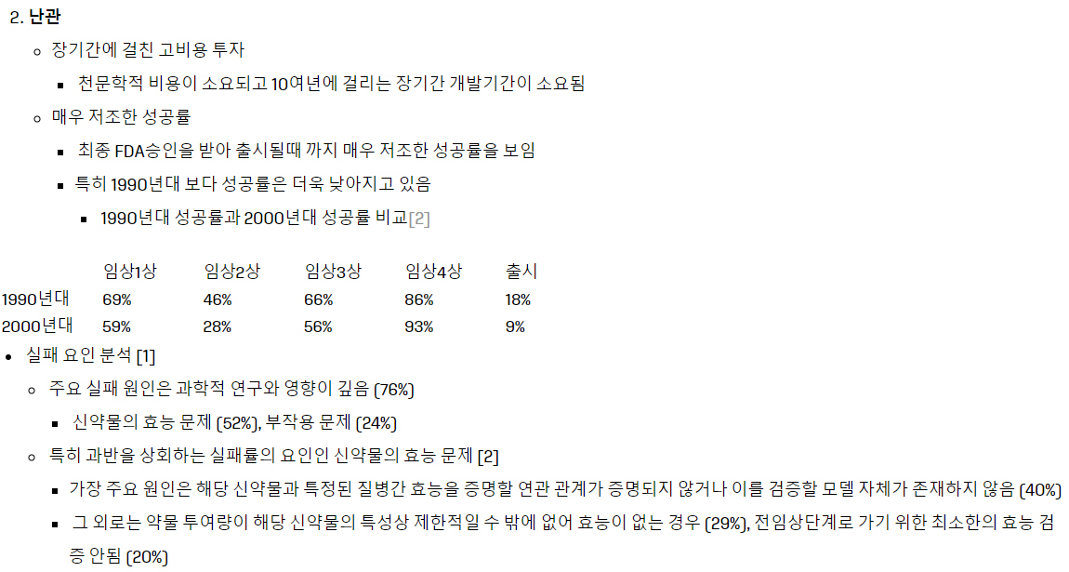
Difficulty in developing new drugs
출처: (2018년 1월) 정밀의학 바이오신약개발 연구 최신 동향 및 전망 인공지능과 정밀의학
출처: (Nature 2004) Key factors in the rising cost of new drug discovery and development

Slide 18
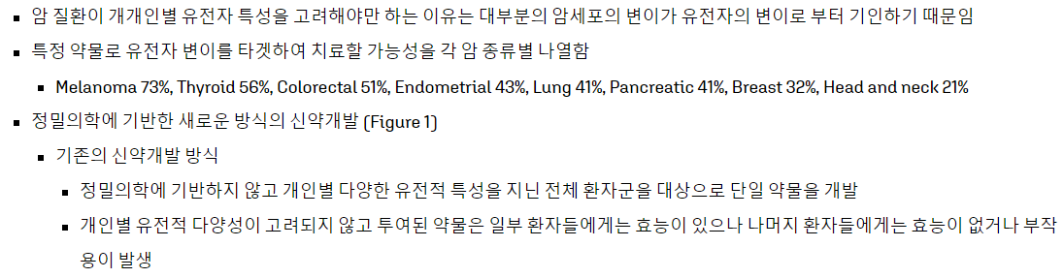
The importance of diversity for the development of new drugs
출처: (2018년 1월) 정밀의학 바이오신약개발 연구 최신 동향 및 전망 인공지능과 정밀의학

Slide 19
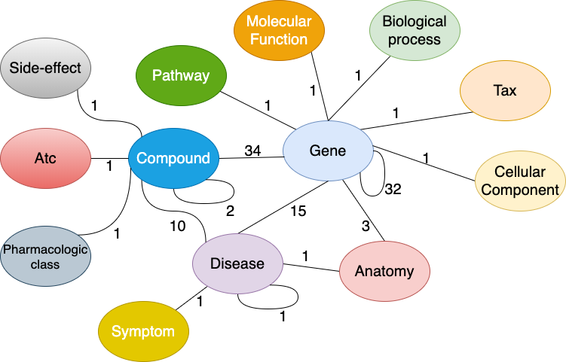
The characteristic of Knowledge Graph(KG)
출처: https://github.com/gnn4dr/DRKG

Slide 20
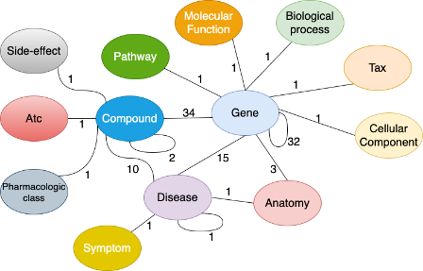
Method
Keyword1
BIO Search
Input : Symtom
Keyword2
Keyword Expansion
Keyword1
Keyword2
Keyword3
Keyword3

Slide 21
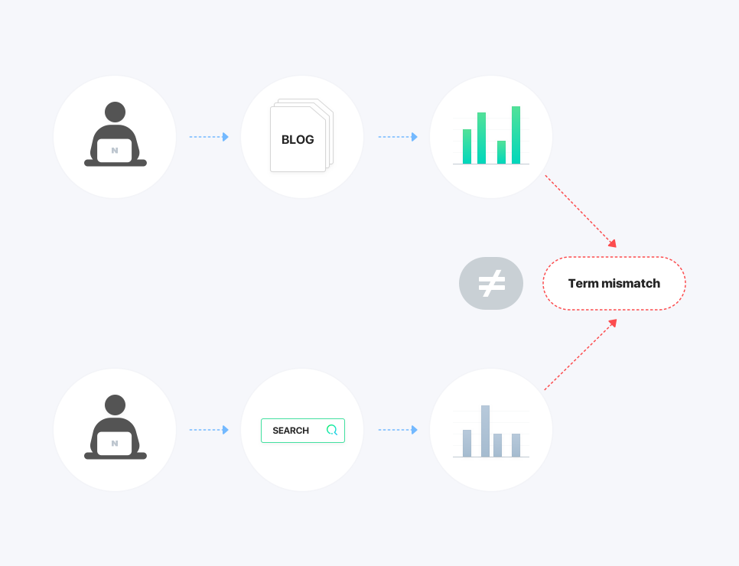
Research theme1
문제점 : 어휘 불일치 문제 (term-mismatch problem)
query term과 relevant doc 간의 “vocabulary mismatch” problem는 IR의 메인 challenge중 하나
‘댕댕이’로 검색했을 때, ‘강아지’의 검색결과를 얻을 수 없음
Ex)
강아지,
댕댕이,
반려견
참고: https://blog.naver.com/naver_search/222147456679

Slide 22
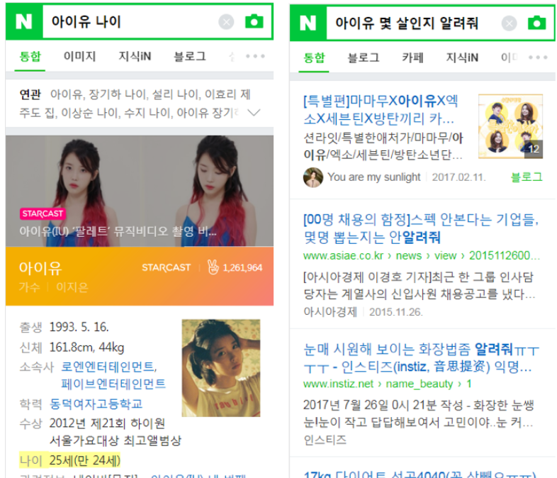
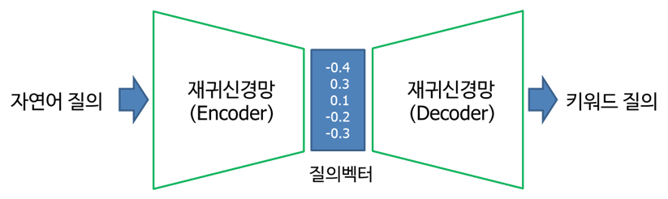
Research theme2
문제점 : 자연어 질의에서 키워드 질의로 변환
(SIGIR ’17) RNN기반의 자연어 질의 변환[네이버]
<키워드 질의>
<자연어 질의>
참고: https://blog.naver.com/naver_search/221066184768

Slide 23
Next research paper
문서 확장 기반의 질의
Document Expansion versus Query Expansion for Ad-hoc Retrieval
BERT-based Lexical Substitution
Leveraging Semantic and Lexical Matching to Improve the Recall of Document Retrieval Systems: A Hybrid Approach
Document Expansion by Query Prediction
KG 기반의 키워드 확장 기반의 질의
Siamese network

Slide 24
Next research paper
CS224W – GNN 위주로 공부 예정
Chapter 01~06 (6) : Graph의 구조적 특성, Message Passing
Chapter 07~12 (6) : GNN 이론, PageRank
Chapter 13~18 (6) : GNN 응용, KG, GNN한계
GNN기반의 KG임베딩을 이용한 추천시스템 사례
(Deview 2020) GNN기반의 개인화 추천시스템 (Naver)
(KDD 19’) KGAT: Knowledge Graph Attention Network for Recommendation

Slide 25
Appendix
Thank you

Slide 26
6. Next research paper
Reference
https://learniiing.tistory.com/5 (KG Completion - TranE, TransR)
https://velog.io/@tobigs-gnn1213/17.-Reasoning-over-Knowledge-Graphs (GNN 스터디)

